Slide 1
Omicron sentimental analysis

Slide 2
Contents
Introduction
Data Source
Analysis tools
Model
Results

Slide 3

Introduction
On November 24, 2021, a new variant was reported to the World Health.
This new variant was first detected in specimens collected on November 11, 2021 in Botswana and on November 14, 2021 in South Africa.
On December 1, 2021 the first confirmed U.S. case of Omicron was identified.

Slide 4
Introduction
Conducting a sentimental analysis on what people are thinking of Omicron virus
Finding the geographical areas that are tweeting about the virus

Slide 5
Data Source
The data was collected using Twitter API to find all tweets having the word Omicron
The dataset contains information about the usernames, user location, tweets and etc.
The data is updating frequently in Kaggle.

Slide 6
Analysis Tools
For conducting the project I have worked on:
PyCountry → to get the geographical information and the list of the countries
Clean-text → to clean the data from hashtags, emoji and mentions
Stopwords → to not include some words in the sentimental analysis like Covid-19 and Omicron
NLTK → tool to use for sentimental analysis
TextBLOB → tool to use for sentimental analysis
Wordcloud → To visualize the what are the most used positive/negative words

Slide 7
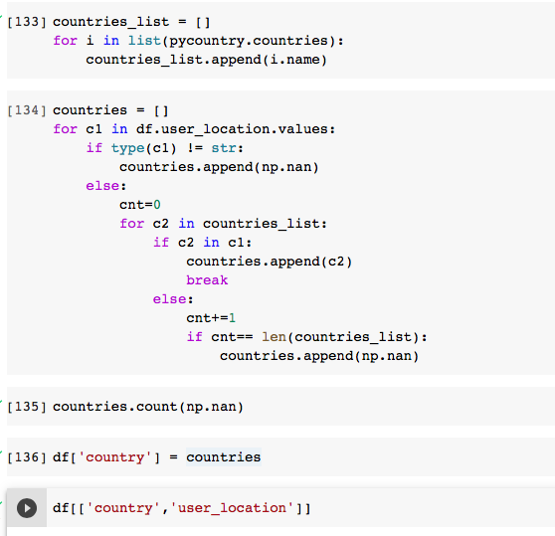
Geographical Analysis

Slide 8
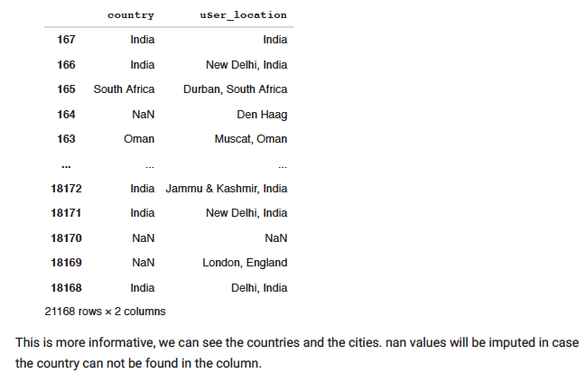
Model

Slide 9
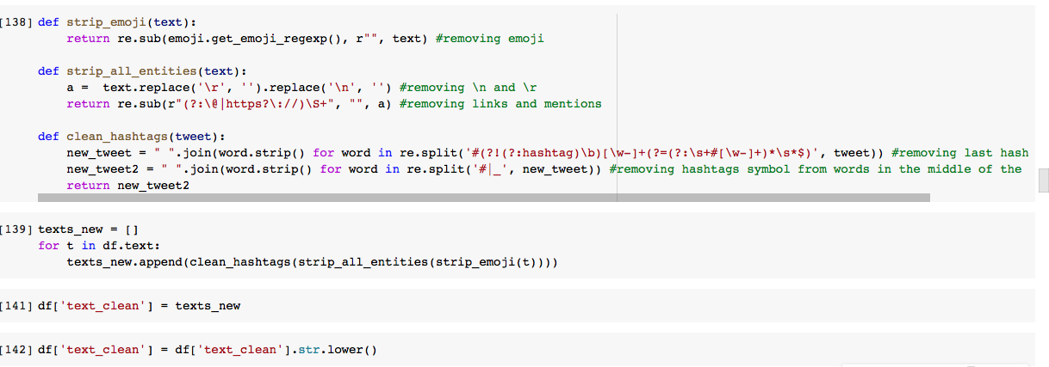
Text Cleaning

Slide 10
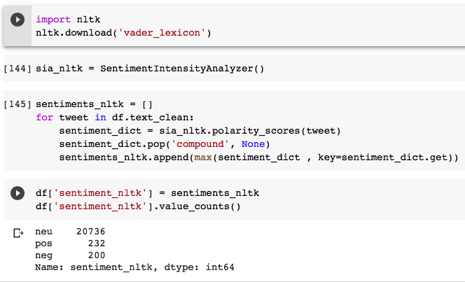
Sentimental Analysis (NLTK tool)

Slide 11
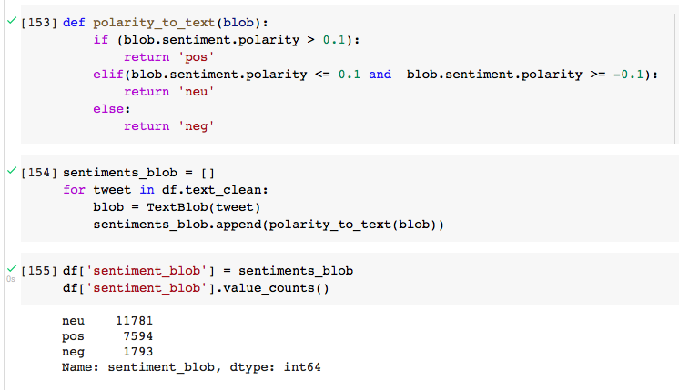
Sentimental Analysis (TextBLOB tool)

Slide 12
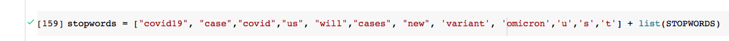
Stopwords

Slide 13
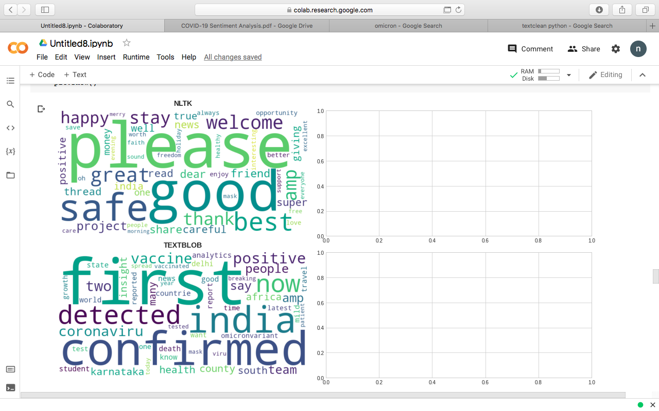
Wordcloud (positive words from NLTK and TextBLOB

Slide 14
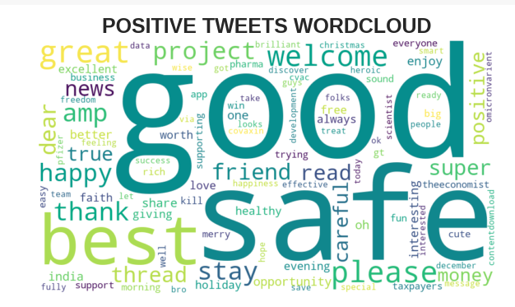

Slide 15
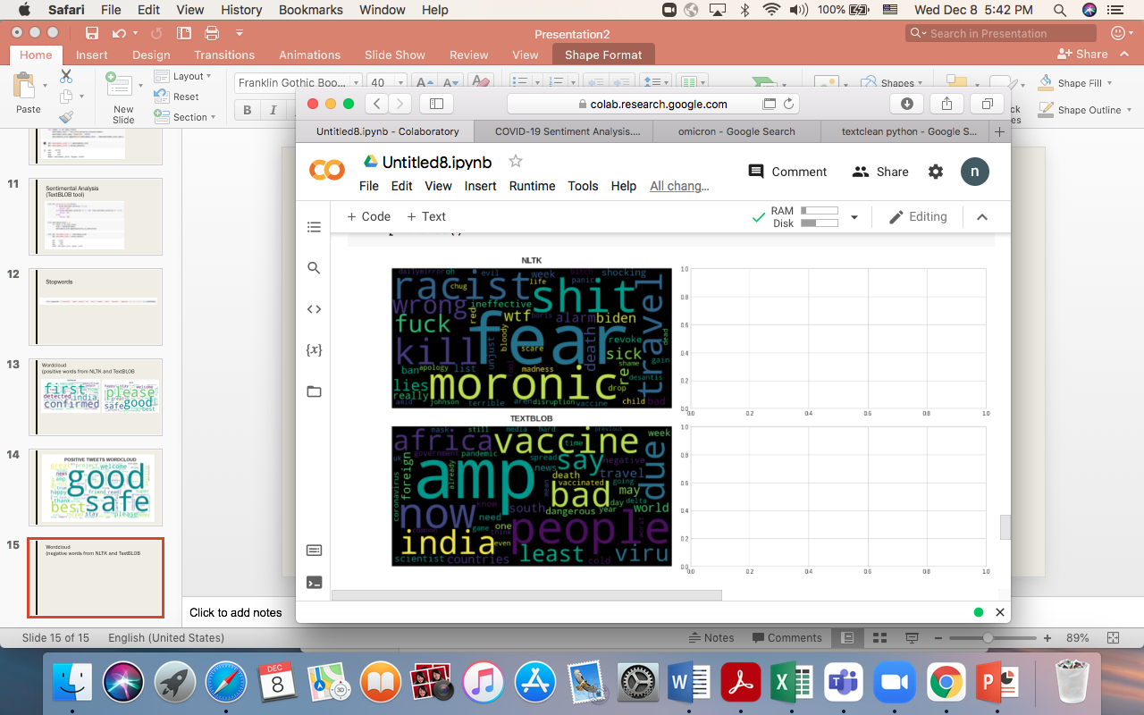
Wordcloud (negative words from NLTK and TextBLOB

Slide 16
